Slide 1
HeroRATS: Detecting Tuberculosis
Authors:
Xin Ya Xu
Richard Ye
Notes:
change title to hero rats

Slide 2
Table of Contents
I
Executive Summary (includes our goal/purpose)
Background
APOPO
Tuberculosis
Rats
Data and Analysis
Understanding the columns
Descriptive Statistics
K-means Clustering
Hierarchical Clustering
Conclusion
What we have achieved
Limitations
Next Steps
II
III
IV
Notes:
Today we’ll be going over the purpose of the project and who Apopo is, before delving into our analysis of the data and application of clustering algorithms on it.

Slide 3
Executive Summary
I
After understanding APOPO’s work, we set out to understand the data. Through this process, we’ve drawn insights from the data and descriptive statistics which we used to solve the task at hand.
Our Goal:
Improve both sensitivity and specificity of the rats
Notes:
increase font

Slide 4
Background
II
Protect people and the planet with innovative solutions using trained rats and other scent detection animals.

Slide 5
APOPO is is based at the Sokoine University of Agriculture in Tanzania, but operates in Cambodia, Zimbabwe, Angola, Mozambique and Ethiopia
Notes:
increase font, remove the first two points

Slide 6
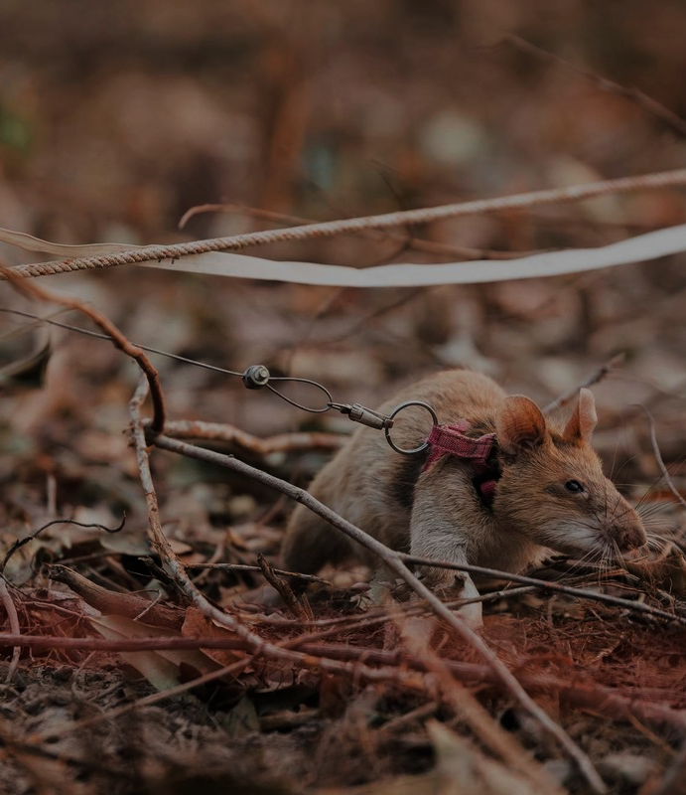
HeroRATS
African giant pouched rats
The rats are highly intelligent, have a highly developed sense of smell, light, and cheap to maintain.
Tuberculosis Progress (1997-2020):
718,730 TB samples screened
169,020 potential infections halted
Notes:
Here we talk about the animals Apopo employs
Remove the part about the dogs

Slide 7
Tuberculosis (TB)
Tuberculosis (TB) is an infectious disease that most often affects the lungs. The WHO estimates that one-third of the world population is infected with TB.
Ethiopia
1.4 Million
> 50%
Tanzania
of patients with active tuberculosis are diagnosed in sub-Saharan African countries
people died of TB in 2019
10
Million
Mozambique
Only 43%
APOPO works in 3 of 30 high TB burden countries of Tanzania, Mozambique, and Ethiopia
of all TB-positive patients were correctly diagnosed in 2019 on the African continent
new infections of TB in 2019

Slide 8
The HeroRATs
Speed
Detection
Rats take as little as 20 minutes to evaluate 100 septum samples for TB, whereas a human may take up to 4 days
In 2020, they helped increased detection rates by 48% for over 48,000 patients and found 2,236 new TB cases.
1
3
2
4
Cost
Abundant
To evaluate a single sample using a HeroRAT could be as low as €1
African giant pouched rats are everywhere in sub-Saharan Africa
Notes:
remove the 48k patience line

Slide 9
Data & Analysis
III
Notes:
Now we’ll take a look at the data and then some descriptive statistics

Slide 10
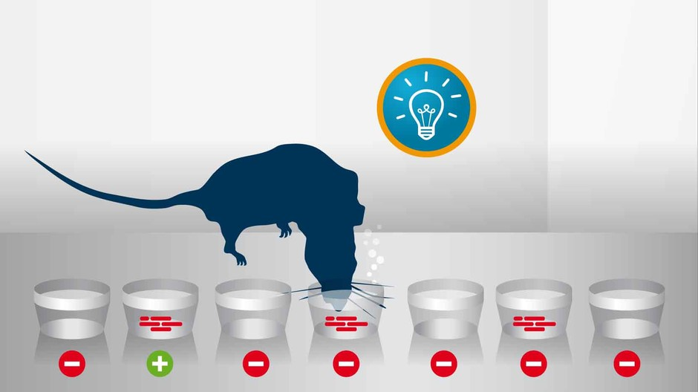
Notes:
We’ll explain how APOPO uses the rats:
10 samples are placed in holes
Each sample is labelled true and false, some true samples are labelled false which are known as blind positive samples
The rat will sniff each sample, and any sample the rat has sniffed for more than 3 seconds indicates it is a true sample

Slide 11
The Data
Human Microscopy results
WHO Approved results
ID_SAMPLE | ID_EVALUATION_SESSION | SESSION_DATE | Program | RAT_NAME | HOLE | ID_BL_DOTS | ID_GXP_DOTS | ID_BL_APOPO | ID_GXP_APOPO | STATUS_DEFINITIVE | STATUS_KNOWNPOS | STATUS_ BLINDPOS | HIT
730354 | 13057 | 01-Sep-20 | Dar | Serena | 1 | 1 |  |  |  | 0 | FALSE | FALSE | FALSE
730305 | 13057 | 01-Sep-20 | Dar | Serena | 2 | 1 | 1 |  |  | 0 | FALSE | FALSE | FALSE
730310 | 13057 | 01-Sep-20 | Dar | Serena | 3 | 1 | 1 |  |  | 0 | FALSE | FALSE | FALSE
730365 | 13057 | 01-Sep-20 | Dar | Serena | 4 | 1 |  | 1 |  | 0 | FALSE | FALSE | FALSE
730315 | 13057 | 01-Sep-20 | Dar | Serena | 5 | 1 | 1 |  |  | 0 | FALSE | FALSE | FALSE
730326 | 13057 | 01-Sep-20 | Dar | Serena | 6 | 1 | 1 |  |  | 0 | FALSE | FALSE | FALSE
730337 | 13057 | 01-Sep-20 | Dar | Serena | 7 | 1 |  |  |  | 0 | FALSE | FALSE | FALSE
730332 | 13057 | 01-Sep-20 | Dar | Serena | 8 | 1 |  |  |  | 0 | FALSE | FALSE | FALSE
730451 | 13057 | 01-Sep-20 | Dar | Serena | 9 | 13 |  |  |  | 2 | TRUE | FALSE | TRUE
730377 | 13057 | 01-Sep-20 | Dar | Serena | 10 | 1 | 1 | 1 |  | 0 | FALSE | FALSE | TRUE
…
Omitted some columns and most rows
…
Notes:
We had 220 thousand rows of data (num samples)
Columns with DOTS are the results from human testing samples with microscopes
Columns with APOPO are the results from WHO approved methods
STATUS_DEFINITIVE will be explained soon
STATUS_KNOWNPOS and BLINDPOS are the evaluation results from the DOTS lab
HIT is the rats evaluation
Like we mentioned, we want to improve the sensitivity and specificity of each rat.
How can we do that? Teams. Before that we must look at each rat’s individual sensitivity/specificity

Slide 12
Individual rat statistics
Notes:
We will also define what sensitivity and specificity are, and the ways they are defined.

Slide 13
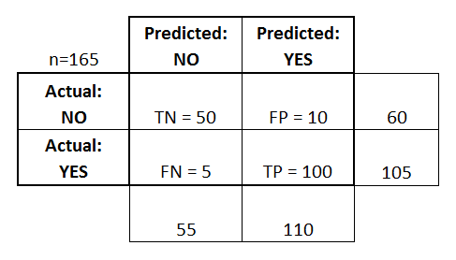
$$Sensitivity = \frac{100}{105}$$
$$= 95.23\%$$
$$Specificity =\frac{50}{60}$$
$$= 83.33\%$$
Confusion Matrix

Slide 14
Sensitivity Definition
Sensitivity 1: HITS / STATUS_KNOWNPOS
Of all the positive known samples from the DOTS lab, how many did the rat get right?
Sensitivity 2: HITS / STATUS_BLINDPOS
Blind Positive samples: Known positive samples that were labelled negative to remove any possible signaling from the trainer or environment to the rat
Sensitivity 3: HITS / STATUS_DEFINITIVE
STATUS_DEFINITIVE: It combines the results from the DOTS lab (human evaluation) and a second layer evaluation in the APOPO lab (using WHO approved methods which are ~90% accurate) where the second layer overrides the results from the DOTS lab.
Notes:
From APOPO, they defined sensitivity three different ways.
(read from slides)
Sen 3: For example, if a sample is negative as according to the DOTS lab, ID_BL_DOTS or ID_BL_GXP,

Slide 15
STATUS_DEFINITIVE Example
ID_BL_DOTS = 1
ID_BL_APOPO = 5
HIT = TRUE
Sample status: Negative
Sample status: Positive
Sensitivity: 1/1 = 100%
Notes:
If the lab technicians using the microscope don’t find much bacterial content, they will declare the sample negative
If APOPO re-examines the sample using WHO methods, and find it to be positive, it overrides the previous result
If a rat determines it is true, then that rats sensitivity is 100%.

Slide 16
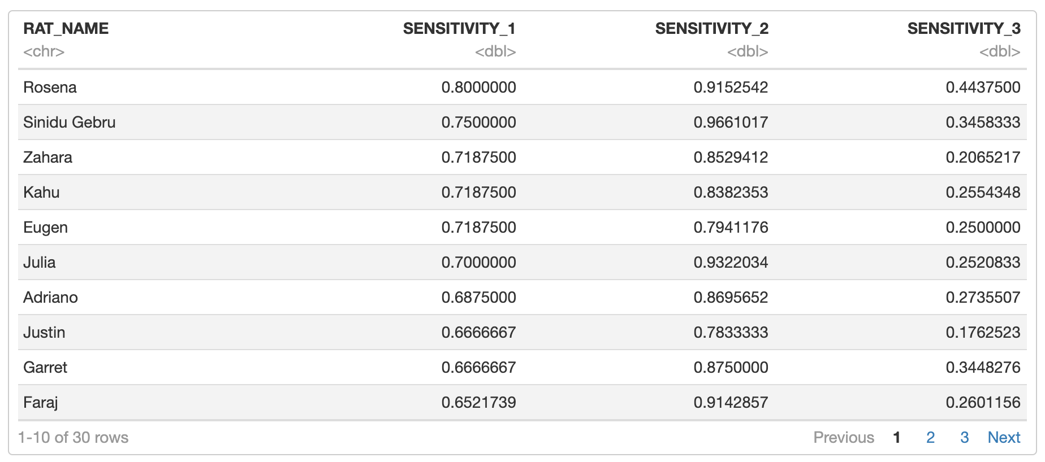
Sensitivities
Notes:
We have 30 Rats in total
Ordered by highest sensitivity
Not really useful since all this tells us is some rats are better at detecting positive samples than others, but it doesn’t allow for comparing.
Because not all the rats evaluated the same samples
We will be using sensitivity 3 as the default sensitivity from now on

Slide 17
Specificity Definition
Sensitivity 1: !HITS / (ID_BL_DOTS or ID_GXP_DOTS)
Of all the negative known samples according to the DOTS lab, how many did the rat get right?
Sensitivity 2: !HITS / STATUS_DEFINITIVE
Blind Positive samples: It combines the results from the DOTS lab (human evaluation) and a second layer evaluation in the APOPO lab (using WHO approved methods which are ~90% accurate) where the second layer overrides the results from the DOTS lab.
Of all STATUS_DEFINITIVE samples, how many did the rat get right?
Notes:
APOPO defines specificity two ways as well, and like sensitivity we’ll use the definition associated with STATUS_DEFINITIVE

Slide 18
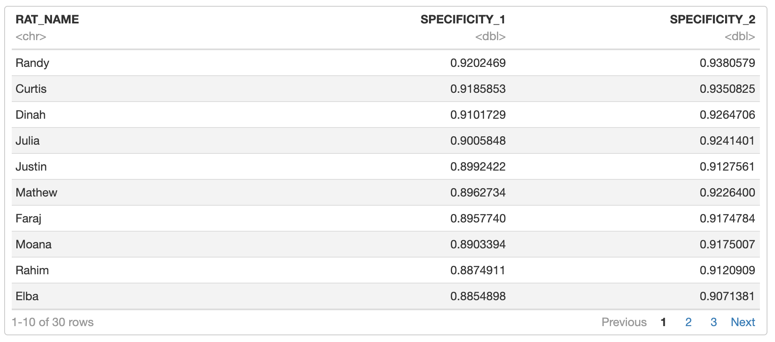
Specificities
Notes:
All the specificities are quite high compared to the sensitivities
Rats alone seem to be very good at detecting false samples compared to positive samples

Slide 19
How can we combine the strengths of these hero rats to increase metrics?
Each rat has unique strengths and weaknesses, but how do we find a combination of rats that gives the best sensitivity and specificity?
Notes:
The way we’re going to tackle this is by combining rats into teams. This is important because how we group rats into teams and define sensitivity could impact how well they perform as a team.

Slide 20
HeroRAT Teams
How are teams decided?
By samples sniffed (ID_SAMPLE)
If a group of rats sniffed the same samples
By evaluation session (ID_EVALUATION_SESSION)
If a group of rats participated in the same evaluation session
How is team sensitivity and team specificity measured?
Of positive samples, the prediction is true if at least one rat predicts true.
Of negative samples, the prediction is false only if all rats predict false.
Notes:
Grouping rats into their respective teams is important because the rats are not comparable if they have not evaluated the same samples.
We grouped by evaluation session since they’ve evaluated the same samples in a given session, and are part of the same program/location
Within these groups we can further sub-group rats into more productive groupings

Slide 21
Teams by ID_EVALUATION_SESSION
Team Num | Rats in team
1 | Adriano, Charlotte, Dian, Dinah, Elba, Eugen, Justin, Kahu, Zahara
2 | Adriano, Charlotte, Dian, Eugen, Kahu, Zahara
3 | Adriano, Dinah, Elba, Eugen, Garret, Justin, Kahu, Zahara, Zahoro
4 | Adriano, Dinah, Elba, Eugen, Justin, Kahu, Zahara
5 | Adriano, Elba, Justin
6 | Campbell, Curtis, Faraj, Julia, Mathew, Moana, Rahim, Randy, Rosena, Sinidu Gebru
7 | Campbell, Curtis, Faraj, Mathew, Moana, Rahim, Randy
8 | Carolina, Eunice, Freddy, Garrett, Magufuli, Oprah, Princess Leia, Serena, Violet, Zahoro
9 | Carolina, Freddy, Princess Leia, Serena, Violet
10 | Charlotte, Dian, Eunice, Magufuli, Oprah
11 | Eunice, Garrett, Magufuli, Oprah, Zahoro
12 | Eunice, Magufuli, Oprah

Slide 22
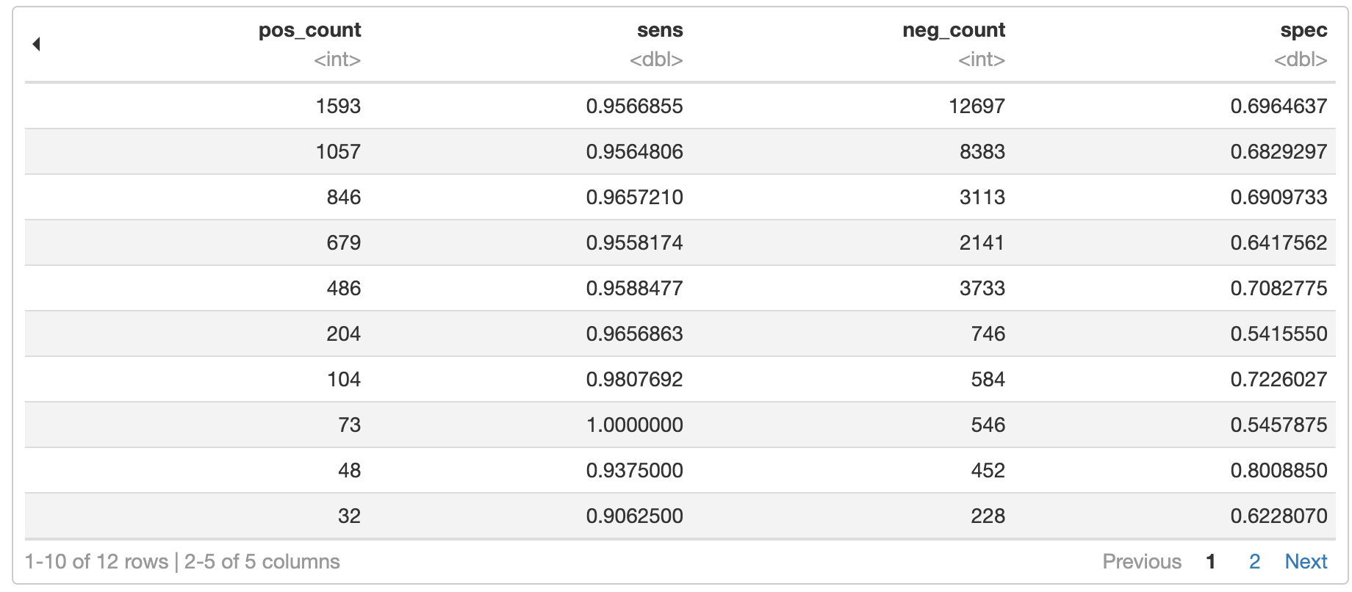
Team Statistics
Notes:
The sensitivities contain much less zeroes now, suggesting that this method of grouping rats into teams may be more correct
We can observe that the rats are much better at detecting the blind positive samples than the known positive samples or the status definitive positive samples

Slide 23
With this information, what do we do?
Measure distance between rats and grouping the most different rats
Notes:
Our strategy grew from the idea two rats that are paired together within their teams would catch more samples since we only need one to report positive for the pair to report positive. The greater the distance between rats, the greater that coverage.
There are many statistics we can use to compare pairs of rats, so we selected a couple features on the next slide
A note that the rats were only paired with eachother within their respective teams, or their performance wouldn’t be comparable

Slide 24
K-Means Clustering
Clustering rats using descriptive statistics

Slide 25
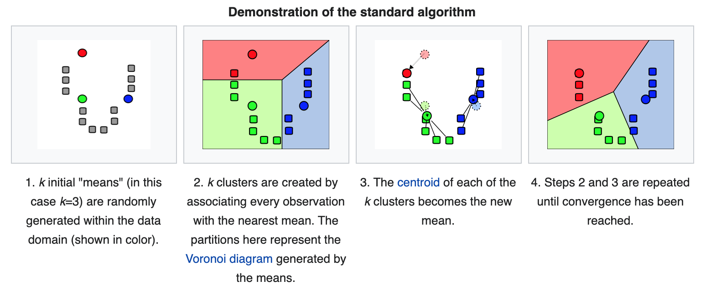
What is K-Means Clustering?
Unsupervised Learning Algorithm
Notes:
Segmentation problems are often tricky because we are not working with any target variable in mind. This is where unsupervised learning comes in where we need to figure out patterns and structures without a set outcome in mind.
Lets discuss how K-means works: It first places a number of random centers within the dataset which you decide, and points are assigned to each center. After all the points are assigned, the means of each cluster is recalculated. This process is described on the next page.

Slide 26
Assigning points to cluster with closest mean by least Euclidian distance:
Recalculate means of clusters using the data points in that cluster:
Finished when the means no longer change

Slide 27
Objective of K-Means Clustering?
Group similar rats together
Pick rats from each cluster to create a new team of different rats
Improve new team sensitivity and specificity

Slide 28
Rat Feature Vector – The Input
Vectorize rats based on their performance
We are looking for the most different rats in all aspects of their performance
Notes:
For the features, we picked each rats
sensitivity,
specificity,
the variance of both measures,
their ability to detect new cases, determined by the rats ability to detect cases which were originally negative from the DOTS lab, and deemed positive by APOPO

Slide 29
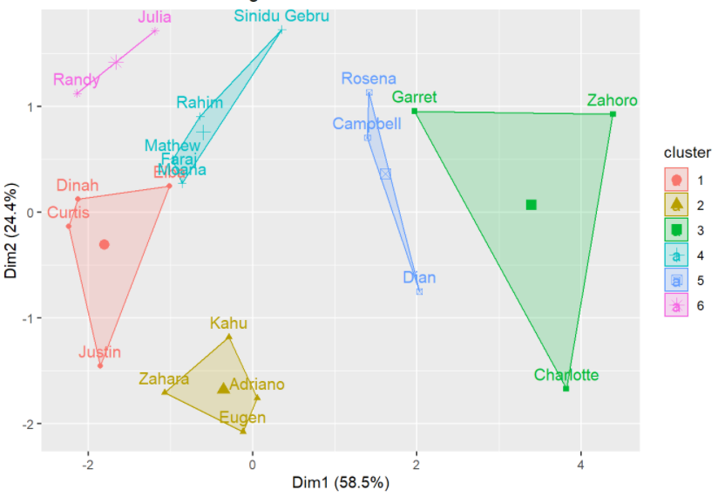
Clusters – The Result
No measurable way to collect rats from various clusters together
Cannot guarantee sensitivity or specificity would improve
Clusters are built on individual rat statistics; cannot evaluate team statistics between rats that have not evaluated the same samples
Notes:
Conclusion: hard to determine the cluster size, how many teams do we want?
Initially wanted to pick one rat from each cluster, but clusters are sized differently so it's hard to tell which rats are different.
This method is therefore of little value for our purposes, but would be useful in understanding which rats are most similar.

Slide 30
Hierarchical Clustering
Another clustering technique that addresses some of the limitations of K-Means clustering.
Notes:
Another clustering technique we worked with is hierarchical clustering, which addresses some of the limitations of k-means clustering that Richard talked about.

Slide 31
What is Hierarchical Clustering?
Unsupervised Learning
Building a hierarchy of clusters, resulting in a tree-like structure
Advantage compared to other clustering algorithms:
Able to show the process of clustering which allows us to understand the individual relationships between rats
Does not require pre-determining the number of clusters as required with K-Means clustering.
There are 2 types of hierarchical clustering:
Agglomerative clustering (AGNES)
Divisive clustering (DIANA)
Notes:
Like K-means, its is an unsupervised learning algorithm where we are dealing with data that is not labelled. The algorithm builds an hierarchy of clusters which results in a very easy to interpret tree-like diagram which we will talk about shortly. Why we chose this clustering algorithm is because of the advantages it has over other clustering techniques. One of the advanatges is that by producing a tree-like structure, it is able to show the process of clustering which allows us to understand the individual relationships between rats even in the same cluster. Another advantage is that this algorithm does not require pre-determining the number of clusters as required with K-means clustering, since we often don't know how many clusters we would have.
There are two types of hierarchical clustering, agglomerative and divisive.

Slide 32
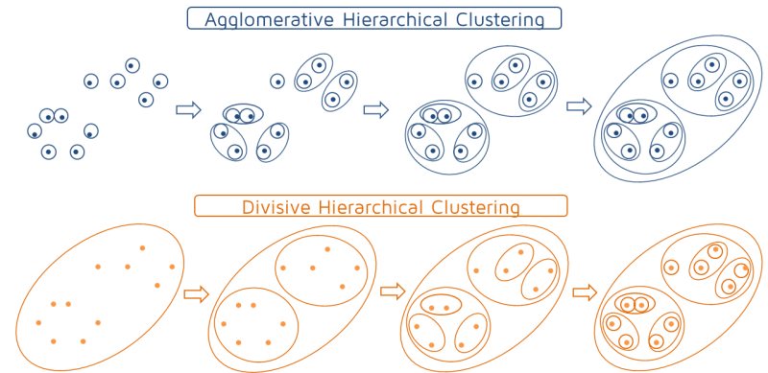
What is Hierarchical Clustering?
Notes:
Agglomerative works in a bottom-up manner. The algorithm first considers each object as a single-element cluster and combines two clusters that are the most similar to each other in each additional step. This procedure is iterated until all points are part of a single cluster. And Divisive is the opposite where it starts with one big cluster and divides into two most different clusters in each additional step until it reaches single element clusters. We will mainly focus on agglomerative approach.

Slide 33
Vectorizing rat pairs
Columns:
Pos_count: Number of positive samples that both rats sniffed
Neg_count: Number of negative samples that both rats sniffed
Similarity: Percentage of the total positive samples where both rats detected the sample to be positive
Dissimilarity: Percentage of the total positive samples where one of the rats detected to be negative and the other detected to be positive
Misses: Percentage of the total positive samples where both rats detected the sample to be negative (HIT == FALSE)
Specificity: Percentage of the total negative samples where both rats detected the sample to be negative (HIT == FALSE)
Notes:
Now We need to find some sort of feature vector to cluster the rats. Hierarchical clustering calculates similarity based on a distance matrix between pairs of rats so we need to find vectors for each pair of rats. Here are some important variables we would like to cluster by.
*list variables*
Pos_count and neg_count will not be used as features but we need them to normalize the other variables so we have percentages.
Similarity, dissimilarity, and misses together makes up all of the positive samples, so these 3 metrics add up to 100%. Specificity is the same definition as what we had before.
-focus mainly on misses and specificity

Slide 34
Vectorizing rat pairs
Let's say Adriano and Campbell sniffed 3 known positive samples and 2 known negative samples together.
Adriano has vector (1,0,0,0,0), where 1 is TRUE, 0 is FALSE
Campbell has vector (1,1,0,0,1), where 1 is TRUE, 0 is FALSE
Let the first three values represent the known positive samples and last two be the known negative samples.
Pos_count: 3
Neg_count: 2
Similarity: 1/3 = 0.33
Dissimilarity: 1/3 = 0.33
Misses: 1/3 = 0.33
Specificity: 1/2 = 0.5

Slide 35
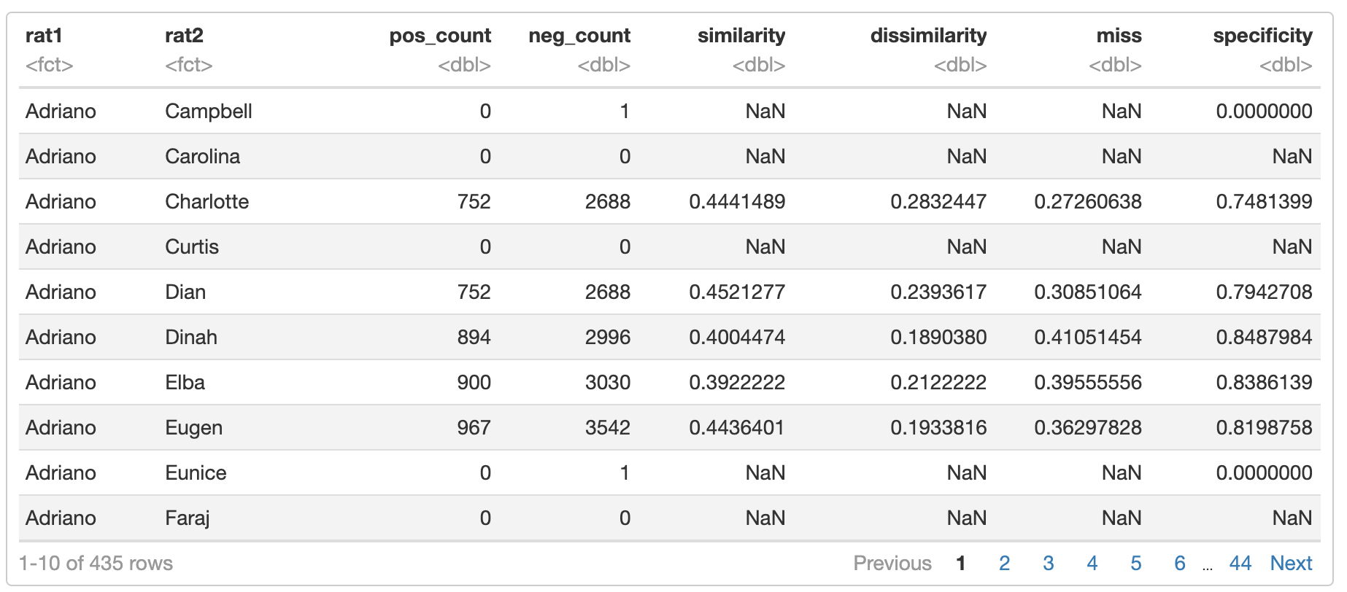
Vectorizing the rat pairs
Notes:
Using the same method as we just did in the example, this is what we get for each pair of rats. The values for each column is the percentage we talked about but also represents the distance between the pair of rats for that variable, and pairs with smallest distance are clustered together because it means that they are the most similar.
There are some NA values which means that the pair of rats did not sniff any common samples and so we will not be included those in our distance matrix. And here I just want to talk about why we chose to focus on specificity and misses.
As Richard mentioned before, we are mainly focused on improving sensitivity and specificity so specificity is an important variable. And we will actually be using 1- specificity because this value represents the distance between the rats. if we use these original values, that means pairs of rats who have high specificity together will actually be far apart and their performance will be misrepresented in the result. And our objective is to represent them in a way where they are close to each other and will be clustered together, which is why we are using 1-specificity.
As for sensitivity, we can focus only on the misses variable because if we try to minimize misses, that means we are maximizing similarity+ dissimiliarity (which I've said before similarity+dissimilarity + miss = 100% of positive samples/snesitivty) which by definition is the percentage of positive samples that the pair of rats have accurately detected.

Slide 36
Distance Matrices – The Input
Team 6: Specificity matrix
Team 6:Miss matrix
Notes:
We can pull pairs of rats from the table we have into a distance matrix. But we needed to be careful about the pairs with no samples or very few samples, like adriano and campbell.

Slide 37
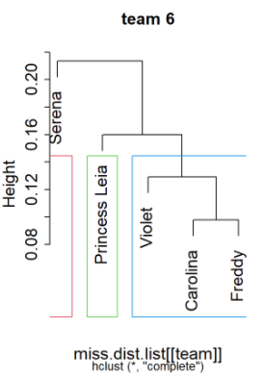
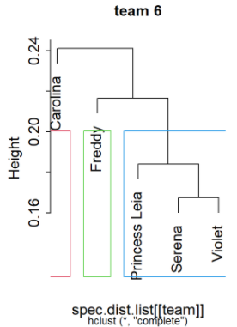
Dendrogram – The Result
Miss Dendrogram
Specificity Dendrogram
Notes:
The result of hierarchical clustering is a dendrogram, which is a tree-like structure that I have mentioned before which shows us the sequence of splitting and merging the clusters representing the relationship between rats even in the same cluster.
Colored boxes are number of clusters we want, which doesn't show us any important information because we have very linear dendrograms. (chaining effect where each cluster is built upon the previously combined cluster).
Looking at the miss dendrogram, you can see that carolina and freddy were clustered first and then violet was added, and then princess leia...etc. This tells us that Carolina and Freddy are like superrats where every other rat in this team is more similar to them than to those who are not in the cluster.
Sensitivity and specificity are inversed
This allows us to find the most specific/ sensitive rats and get an idea how it performs in relation to other rats. We can make a team of very specific rats using this algorithm by selecting those that are clustered first (ie. Serena and violet). Or we can make a team of well balanced rats by selecting specific and sensitive rats. (ie. Violet and carolina)

Slide 38
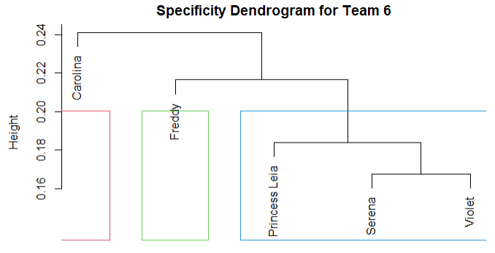
Example
Initial team metrics:
Apply hierarchical clustering:
after
Result of removing most dissimilar rat:
before
Notes:
by using this, we can always create a team with the desired metrics (can increase specificy in a team by removing a rat that is not very specific or increase sensitivity by removing a rat that is not very sensitive)

Slide 39
Conclusion
IV

Slide 40
Recap
Obtain data
Recognize that we need to find ways of grouping the rats together to achieve best possible specificity and sensitivity
Define team specificity and sensitivity
Experiment with clustering techniques with the goal of grouping together multiple rats who work well together.
Notes:
Obtain data which gave us information about rat's reaction to individual samples.
Recognize that we need to improve sensitivity and specificity by groupging the rats together.
Define team specificity and sensitivity -> for sensitivity, if at least one rats detects a positive sample. For specificity, if all rats detects a negative sample.

Slide 41
What we have achieved
Using k-means clustering, we identified teams of rats that had similar abilities, but didn’t help with selecting higher performing teams due to the generalized nature of clustering by features.
Using hierarchical clustering, we achieved the ability to manipulate specificity and sensitivity of teams.
We created teams with at least 90% sensitivity and 70% specificity (World Health Organization's standard for approved TB testing methods
Notes:
Kmeans… + since we clustered the rats by their individual stats, we can't say two rats that have different sensitivities would work well purely based on those values, we'd have to compare them against similar samples they both evaluated.
Hierarchical…

Slide 42
Limitations
Problem concerns animal behaviour which introduces more randomness into our model
Limited data on rat characteristic
Limited data on sample characteristic
Limited observations for different rats with different samples
Data errors
Notes:
Different from normal statistical problems because the data is dependent on rat behaviour and personality (which is introducing more randomness into the data). We found that rats also have good days and bad days where they aren't consistent with their performance.
There were limited model techniques we can use because of the nature of the data. We had limited data on rat and sample characteristics which means that we weren't able to build good models that can predict the performance of rats given a sample.
We can only test groups of rats based on the common samples they sniffed.
Data errors which is expected as it is a real-life dataset, however it did take some time to fix up the inconsistencies.

Slide 43
Next Steps
Improve Modeling
Probabilistic modeling/clustering using rat features and sample features
Improve/Automate Tool
Create an automated tool that can take in data, analyze it, and output the partitioning of the rat.
Notes:
If we can obtain more features/information about the rat as well as the samples, we can build models to predict a rat's performance (sensitivity/specificity) on samples with certain characteristics. This approach will allow us to remove the limitation we talked about before where we are restricted to only grouping together rats who have sniffed common samples.
Another improvement we can make is to automate the work we have done manually during this project. We were given a small part of the huge amount of data at APOPO and its constantly changing everyday. So for our work to be reused for various datasets, the analysis and clustering would have to be automated.

Slide 44
Thank you for listening to our talk!
Let us know how you would approach this problem
Notes:
That concludes our presentation and thank you for listening to our talk! We are open to suggestions, in fact one of our main goals of presenting at this seminar is to expose our problem to more people and get to hear more possible solutions that we haven't thought of. Please feel free to ask questions or bring up any new ideas.

Slide 45
Full Table Schema
Data Variable | Description
DATE_INCOMING | Date the sample was collected from the partner (DOTS) health clinic
ID_SAMPLE | Unique sample ID (note: patients may provide more than 1 sample but each sample receives a unique ID)
ID_PATIENT | Unique patient ID
DOTS_NAME | Name of the partner (DOTS) health clinic providing the sample
ID_EVALUATION_SESSION | Unique ID for each evaluation session. Rats typically participate in a single evaluation session per day with each session containing around 100 samples.
SESSION_DATE | Date the evaluatin session was conducted (i.e., when the rats sniffed the samples).
Program | This dataset includes results from rats working at both our Dar es Salaam ("Dar") and Morogoro facilities. Each facility has more than 1 team of rats.
RAT_NAME | Name of the rat evaluating the sample
HOLE | Cage hole number (1 to 10). The samples are then arranged into bars labeled alphabetically. Thus, the first sample a rat encounters in an evaluation session is A1, the 10th sample is A10, 11th is B1… If it would be helpful, we can run also extract the Bar Letter corresponding to each sample included here to precisely determine where the sample was positioned (and/or in what sequence the rat encountered it) within the evaluation session.
ID_BL_DOTS | Diagnostic result provided by the partnering health (DOTS) clinic using microscopy technique. See Bacterial Level code below. Simply put, any value other than 1 means the sample is TB-Positive.
ID_GXP_DOTS | Diagnostic result provided by the partnering health (DOTS) clinic using molecular (Gene Xpert using PCR) technique. See Bacterial Level code below. Simply put, any value other than 1 (or blank) means the sample is TB-Positive. Blank values mean the sample was not evaluated with this technique.
ID_BL_APOPO | Diagnostic result from APOPO's confirmation lab (where applicable). Note, APOPO typically only applies WHO-endorsed diagnostic methods for samples that the rats have flagged suspect of containing TB (see HIT below) but which the DOTS clinic had found to be negative. See Bacterial Level code below. Simply put, any value other than 1 (or blank) means the sample is TB-Positive. Blank values mean the sample was not subjected to confirmatory diagnostics within our lab.
ID_GXP_APOPO | Diagnostic result from APOPO using molecular technique (less common). See Bacterial Level code below. Simply put, any value other than 1 (or blank) means the sample is TB-Positive. Blank values mean the sample was not subjected to Gene Xpert testing within our lab.
STATUS_DEFINITIVE | This should combine the diagnostic results of both DOTS and APOPO (lab confirmation, when applicable) wherein APOPO status (results) overrides DOTS. For example, if ID_BL_DOTS = 1, but ID_BL_APOPO = anything other than 1, then STATUS_DEFINITIVE = ID_BL_APOPO. NOTE: it likely wouldn't hurt to confirm this logic as a point of internal data validity check.
STATUS_KNOWNPOS | A sample found to be TB-positive from the DOTS clinic. We include these samples within the evaluation session as controls (a sort of internal calibration to ensure the rat is performing accurately) and maintain rat motivation for the task. If the rat correctly indicates these samples (HIT = TRUE), they are rewarded with food.
STATUS_BLINDPOS | A sample found to be TB-positive from the DOTS clinic but which is coded as TB-negative during the evaluation session. Blind samples ensure that rat behavior is driven by the smell of the sample and not inadvertent cueing from the handler. They also teach that rat that they will occassionally encounter TB-positive samples that are not rewarded with food. This "partial schedule of reinforcement" encourages the rat to continue working when/if they correctly indicate a TB-positive sample that the DOTS clinic missed (the very samples we want our rats to indicate/find). Because we do not know if these samples are indeed positive until after the rats have finished evaluating them (and we take them into our laboratory for confirmation), we cannot reward the rat for indicating the sample during the evaluation session. Rewarding rats for indicating actual negative samples would destroy scent detection training and undoubtedly increase false alarms to reduce specificity and efficiency.
HIT | Defined as a continuous sniff (nose insertion into cage hole containing the sample) equal to or exceeding approximately 3-s (as estimated by the rat handler). TRUE means the rat "indicated" the sample (held its nose in the hole for at least 3-s). FALSE means the rat rejected the sample (did not hold its nose for at least 3-s). For reference: If STATUS_KNOWNPOS= TRUE, and HIT=TRUE, the rat receives food reward. If STATUS_KNOWNPOS= TRUE, and HIT=FALSE, this is considered a "miss". If STATUS_KNOWNPOS= FALSE, but HIT=TRUE, this sample is considered "suspect" and subjected to APOPO lab confirmation, This sample should have a corresponding ID_BL_APOPO status (other than blank) provided. IF ID_BL_APOPO = 1, the rat's HIT is considered a "false alarm". IF STATUS_KNOWNPOS=FALSE, and HIT=FALSE, AND STATUS_BLINDPOS = FALSE, AND ID_BL_APOPO (and/or STATUS_DEFINITIVE) = blank, this is considered a "correct rejection".

